Slide 1
Java language
Object Oriented Programming - Java
Chapter 2
FPTU Da Nang – IT Department

Slide 2
Objectives
Completing this chapter, students will be able to:
  Understand and use proficiently the basic components of the Java programming language
  Variables and data types
  Primitive and reference types
  Control command structures
  Function definition and invocation
  Writing Java Applications
  Professional naming technic

Slide 3
Content
Character sets, keywords, captions
Variables & Constants
Datatypes
  Primitive
  Reference
Style conversion & style compression
Command structures
  Assignment
  Branching
  Loop
main() function
Practice : Array of integers: sum, max, min, sort

Slide 4
Character set - keywords - comment
Character set
  Characters, numbers, some symbols..
  Case sensitive
About 50 keywords
  Distinguish keywords & standard names
Naming convention – highly recommend!!!
  Class name starts with a capital letter
  Variable and function names start with a lowercase letter
  Name should be meaningfull, concate words with 1 capital letter Example: int numberOfStudent, class PhanSo
Comment
  On 1 line after the symbol // comment
  Multiple lines: enclose /* comment */

Slide 5
Variables & Constants
A variable is a memory location associated with a name and a data type.
Variable declaration syntax
  dataType varName1, varName2=value, varNameN;
  Ex: int a,b=6,c; char grade='E';
  End with a semicolon ;
Location of the variable declaration determines the scope of the variable
  Local variables - declared in a function or block {}, function argument
  Class variables (class scope)
  Do not allowed variables with same name in the same scope
Constants are variables declared after final keyword
  Must initialize value up on declared & not allowed to change
  Ex: final int A=10;

Slide 6
Variables & Constants
Notes when declaring variables.
  Data range of the variable value
  The size of memory allocated.
  Limit the data errors.
  Data abstraction – data encoding
Example: declaring a variable representing gender
  boolean gender = true;
  String gender=“Male”;
  char sex='F';
  byte gioiTinh = 1;
  int gender=0;
  double gioiTinh= 0.0;
  Which declaration may not valid? Which declaration should be used?

Slide 7
Variables & Constants
Data member variables – class variables
  Receive the default value if not initialized
  Effective inside the class
  Declare inside class, outside method/functions
Local variables
  Must be initialized before accessing
  May have the same name of class variables – will hidie class variables
  Local variables inside blocks & functions cannot have the same name
The data type of the variable specifies how to initialize & assign the variable
  Primitive variables only need to be assigned
  Reference type variables must be initialized and assigned
Member variable of a class has the same name with local variable is distinguished using the syntax this.varName and varName

Slide 8
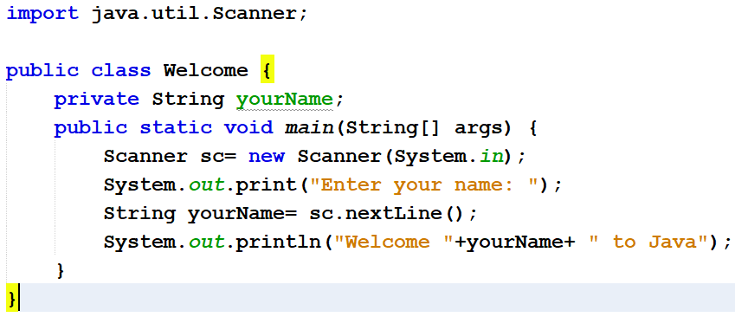
Variables & Constants..
  How many variables of various types are there in the code below?
  How many classes are there? how many functions mentioned?.

Slide 9
Data types
4 characteristics of data types
Two types of data types:
  Primitive types: memory location that stores data
  Reference types: memory loaction that stores the address of a data location
Primitive type
  Logic type : boolean
  Number type
    Integer : byte, short, int, long
    Real: float, double.
  Character type: char

Slide 10
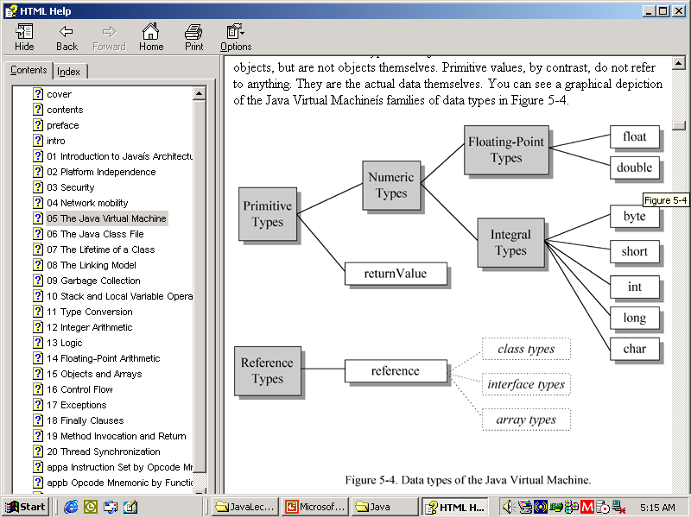
Data types

Slide 11
Logic Data Type
boolean
true, false
1 byte/bit
For example
  boolean isAbsent = true;
  boolean sex = false;
Logical operations run from left to right until the value of the logical expression is determined.
  Math operations &&, || , !, compare returns logical value
  if (x!=0 && y++/x>=3)... Calculation stops if x=0

Slide 12
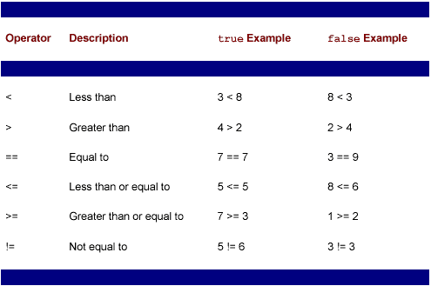
Boolean Operators

Slide 13
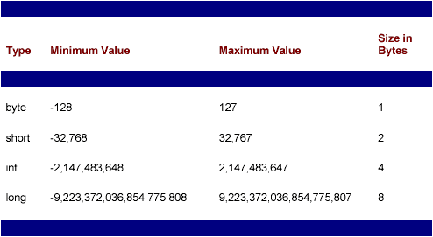
Integer

Slide 14
Double
Range:
  float –32 bit - can be precise to 6 or 7 digits
  double – 64 bit -accurate to 14 or 15 digits
The following value constants represent special values ​​(defined in the Float and Double classes)
    Float.NaN
    Float.NEGATIVE_INFINITY
    Float.POSITIVE_INFINITY
    Double.NaN
    Double.NEGATIVE_INFINITY
    Double.POSITIVE_INFINITY

Slide 15
Numeric operations
All numeric data use the following operators:
  Arithmetic operations +, - , * , /
    byte a=3, b=2,c;
    c=a*b; /* error multiplication a*b automatically converts to int, out of range of c */
    15/2 equals 7 - 15.0/2 equals 7.5
  Remainder division %
    5%3 =2
    3.14%2.2=0.94
  Increment ++ and Decrement -- , before & after
    int a=5, b=7,c; c=a++ +b; // c=12 a=6 c= ++a +b; // c=13 a=6
  Combination of assignment and arithmetic +=, -=, *=, /=, %=
    x+=3; equivalent to x=x+3
The following operations apply to integer types only
  Bit shift left, right <<, >>, and >>>
  Bitwise operations & -and, | -or, ^ -xor, ~ -not
1/3 + 1/3 +1/3 = ?
1.0/3+1/3.0+1.0/3.0==1 (?)

Slide 16
Character data type
unsigned integer type
  char
  using 16-bit Unicode encoding character set
  Character value between parentheses: 'a'
Some special characters
  \t tab key
  \r to the beginning of the line
  \n down the line
  The \" is placed before special characters when you want to print the characters themselves \" , \'

Slide 17
Reference type
Pointer data types
Includes classes, interfaces, and arrays.
The value of a reference type variable is the address refer to an object.
  An object is an instance variable of a class or array.
  A reference variable is actually a pointer (address of memory location) pointing to an object,
  String hoTen= new String(“John Smith”);
  hoTen
  char a='S'; a
John Smith
xx:yy is the address of “John Smith”
xx:yy
S

Slide 18
Reference type
The null constant refers to an empty or uninitialized reference variable.
Reference variables usually must be initialized with the new . keyword
  String hoTen= new String(“John Smith”);
  int[] a = new int[10];
  Student[] list= new Student[5];
  list
  list[1]= new Student(id,name, dob);
The instanceof operator is used to check
whether a reference variable belongs to a class?
  a instanceof Integer // returns true if a is an instance variable of Integer
How many byte allocated?
xx:yy
null s1:o1 null null null
id name dob

Slide 19
Array type
Declare:
  Syntax
    dataType[] varName; or dataType varName[];
    dataType[] varName = new dataType[arraySize];
    dataType[] varName ={comma-separated array elements};
  For example
    int a[]; //declare variable a as integer array, uninitialized
    String b[]={“Java”,”Sun Mircosystem”,”Oak”,”1995”}
    Integer c[]=new Integer[10]; Integer d=new Integer(10);
  Array size can not be changed after initialization.
  The new keyword ask for array’s memory allocation

Slide 20
Array type
Array element reference
  using element index, starting from 0 to n-1
  References beyond the array index are not allowed
  using [] notation: a[0]=12;
Array is a special class – an array is an object
  The length property specifies the number of elements of String array
  a[]= {“a”,”b”,”c”,”def”} -> a.length equal to 4
  Copy array: System.arraycopy(srcArr, fromIndex, destArr, toIndex, elementCount);
  Sorting array: Arrays.sort(arrVar); ascending sort array with comparable elements type.
  Multidimensional array is actually an array of arrays, arrays elements do not necessarily have the same number of elements..

Slide 21
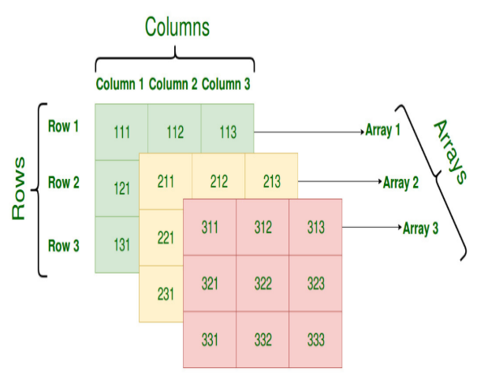
Array type
Assignment of two array variables of the same element type
  Change the reference of the array variable assigned int[] a={ 2,4,6}; int b[]={3,5}; a=b; // a[0]=? a[1]=? a[2]=?
Multidimensional array
  int[][] a=new int[3][5];
  int b[][]={{1,2} ,{3,4,5},{6,7,8,9}};
  Element reference a[row][col]
  Multidimensional array.. a[array][row][col] a[0][3][0]=131

Slide 22
String class
Represent string constants
  Literal string using quotation mark: "abc"
  + operator to concatenate 2 strings
  All data types are automatically converted to string when joining + with 1 string
  A string constant treated as a variable of the String class
  “abc”.length() returns 3
Commonly used functions
  length()
  equals()
  substring()
  charAt()
  indexOf()..
  match(regular expr)
String Pool: mechanism for storing string constants
StringBuffer for string processing, StringTokenizer: string separator

Slide 23
Conditional operator
Syntax:
  (Expr1)? Expr2:Expr3
  Ex: int a= (x>y)?10:5
The expression expr1 must have a logic value
Expr2 and Expr3 can take numeric, logical, or reference values, but must be of the same type
The operand Expr2 & Expr3 can be a function call that returns the same type – (must not void!)

Slide 24
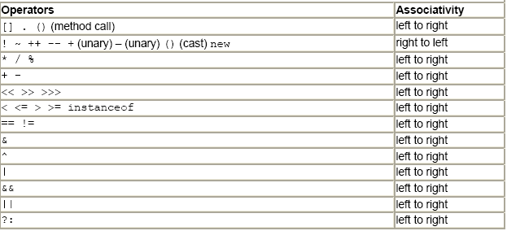
Order of precedence of operators

Slide 25
Type casting
Type casting is the process of transforming the data type of a value/variable/expression, following the following rules:
  Do not convert from reference type to primitive type & vice versa.
  Any value can be converted to String.
  Array type can be converted to Object or String type.
  The numeric type is automatically converted to the larger range numeric type when the two operands are of different types.
Syntax:
  Put (castingType) before the value/expression to be converted
  Example:
  int a = (int)3.14; // cast real value to integer
  float b= 4; //automatically convert
  long c=b; // invalid, must be casted
  Vector d = (Vector)x; // x is cast to Vector

Slide 26
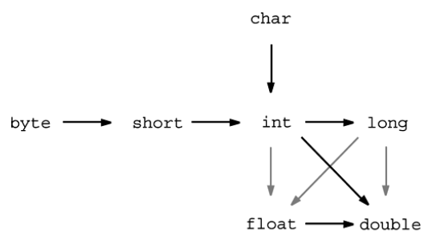
Type casting

Slide 27
Assign Operator
The = sign is used for assignment
  Calculate the value of the expression on the right side, then assign it to the variable on the left side.
  Must be of the same type or automatically convert a valid type
  Returns the assigned value
For example
  double x,y,z;
  x=y=z=3.14; // assign x,y,z with ​​3.14 simultaneously
  String cat='c'; // invalid
  String namSinh=""+1985; // valid
  System.out.println(x=5); // print what?

Slide 28
Conditional statement if()/else
Syntax
if(condition) statement1; else statement2;
    Statement1, statement2 can be a block of code, between the pair of bracket { }
    There can be multiple if()/else nested
    There may be no else . clause
  For example
    byte month, daysOfMonth, year;
    if (month==2) if (year%4 == 0) daysOfMonth =29; else daysOfMonth =28;
    else if(month ==4 || month ==6 || month ==9 || month =11) daysOfMonth =30; else if(month <=12) daysOfMonth =31;

Slide 29
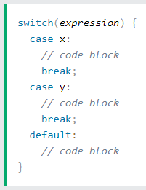
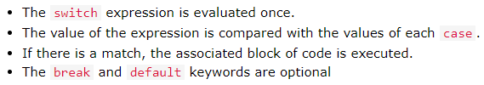
switch statement
switch: to select one of many code blocks to be executed.
switch (month){
case 1: case 3: case 5: case 7: case 8: case 10: case 12: days=31; break;
case 4: case 6: case 9: case 11: days=30; break;
case 2: days=(year%4==0)? 29:28; break;
default: days= -1;
}

Slide 30
While loop
while(condition){statements;}
  Check condition prior to execute
  Unknown number of iterations, ends when condition is false
  Terminate loop any time with break
  Example
    while (x!=y){ if (x>y) x-=y; else y-=x; }
    while (true) { } //an endless loop doing nothing
    while(a<b && b<c) {
    a=a+b;
    b+=c;
    if (a==b+c) break; }

Slide 31
do.. while loop
do {statements} while (condition);
  Execute first, check condition thereafter.
  Unknown number of iterations, ends when condition is false
  Execution at least once
  Terminate loop with break
Example
  do { if (x>y) x-=y; else y-=x; } while (x!=y);
  do { x*=5; if (x>100) break; } while (true);

Slide 32
For loop
for(bk1; bk2; bk3) { statements}
  The loop allows a combination of tasks to initialize variables, check loop conditions, and count the number of iterations.
  bk1 is usually a counter variable declaration & initialization
  bk2 is for the testing loop condition
  bk3 control counter increment
Sequence:
  step 1: bk1 is executed - usually declaration, variable initialization.
  step 2: check bk2, if true then execute statements, otherwise end looping.
  step 3: execute bk3, go back to step 2
Example:
  for(s=0,int i=1; i<=10; i++) s=s+i;
  for(s=0, int i=1; i<=10;) s+=i++;
why variable s is not declared?

Slide 33
For each loop
for(variable: arrayVar) { statements}
  The loop allows exclusively to loop through elements in an array
Example:
  int[] a={ 3,5,7,9,11};
  int s=0; for(int x:a ) { s+=x; }
  Student[] list= new Student[10];
  for(int i=0; i<list.length; i++) {
  list[i] = new Student();
  list[i].getData(); }
  for(Student s:list) System.out.println(s);

Slide 34
Function
Performs a specify task and returns a value
Function definition syntax returnType methodName(arguments)
{ // function body – must have a
return value; // if return type is not void
}
Ex: calculate the greatest common divisor of two integers
  int uscln(int a, int b) {
  a=Math.abs(a); b=Math.abs(b);
  while (a!=b) { if (a>b) a-=b; else b-=a; }
  return a; }
Input
Function
Output

Slide 35
Function call –parameter passing
When calling the function, parameters are passed to the function with the quuantity, order and data type corresponding to the declared arguments.
Pass-by-value: Changes to the passed argument inside the function do not change the value of the original passed argument.
  Example: The function calculates the greatest common divisor of two integers
  int uscln(int a, int b) {
  a=Math.abs(a); b=Math.abs(b);
  while (a!=b) if (a>b) a-=b; else b-=a; return a; }
  int x=10, y=15;
  int us=uscln(x,y); //x passes to a, y passes to b, returns 5
  After the function call x is still 10 and y is 15
There is no standalone function, the function declaration must be inside the class

Slide 36
main() function
All executable Java applications must have a main() function, where the program begins execution.
public static void main(String[] args)
  public: keyword specifying access scope
  static: keyword indicates that all instance variables of this application share the same main() function .
  void: returns no value
  String[] args :
    argument of main
    usually passed from the command window when running ct
    args[0] is the first argument..

Slide 37
Chapter II exercises
Write a program that prints your name, work office, and the greeting "Welcome to Java"
  System.out.println(String x): prints the string x
  Name the file with the same class name, notice Java – case-sensitive.
Write a program IntArray
    initializes an array of n integers, n is passed vie main() arguments
    random initialization of array elements <=30,
    sort array ascending,
    print out the list of elements,
    sum of element values,
    count how many elements have even value
  Integer.parseInt(s) converts string s to integer value
  Math.random(): function returns a random double value betwwen 0 and 1
  Arrays.sort(a): sort ascending array a
  Put this line at the beginning of the program to declare the use of Arrays import java.util.Arrays;

Slide 38
Constructive Questions
How should naming parttern to be used for easy of code reading?
Count the number of variables used in a code block.
Classifying variables in Java
Why are there only 4 primitive data types: integer, real, character, logical?
Why do you need data types? Is there any language that doesn't need to declare data types when declaring variables?
How many data types are there in Java?
Declare at least 4 way of variable declaration to represent data of your choice. Indicate which declaration should be used and explain.
Compare keyword and identifier
To convert GPA score to letter grades, which command structure should be used?
Why is there no pointer type in Java like in C?

Slide 39
Constructive Questions
Which iteration structure should be used to sum the following sequence S=1+1/2+1/3+…+1/n, given 1/n >e
Give at least 3 example code block where the loop runs endlessly
Declare a function that calculates the area of ​​a triangle –
List all available declarations and indicate the best one in your opinion
Write a function to sum the elements of an integer array
How to check a String meets the date format?
Write a function to swap two integers
Compare array in C and in Java
Make a request to perform a certain task and convert it to function coding.
Write a function that takes an argument of reference type. Make possible changes of this argument inside the function and display the changes after calling the function. What kind of change remains in the argument after calling the function?

